Slide 1
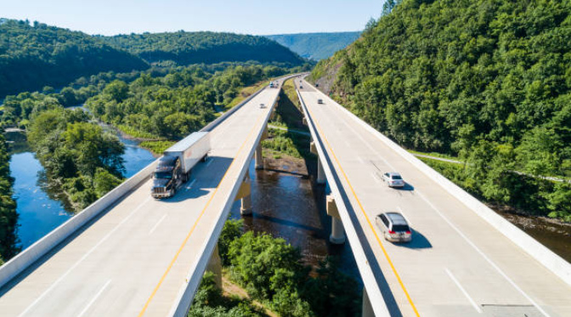
About us
Market demand
Solution & impact
Team and advisors
Contact us
Circular economy based concrete production – TODAY
“
Over the past 10 years, we have led, advised, and helped hundreds of companies to develop and grow their business and succeed in the global market and at the same time become more sustainable. It is our passion to help companies grow and succeed sustainably.
We have recognised that despite efforts in the construction industry, focus on more sustainable concrete has been to reduce one of more raw materials, whereas we want to focus on circular economy and its tremendous potential in reducing CO2 and improving profitability.
Working together with inventors, university research and construction professionals we have developed a methodology, mixing and process to better utilise demolished concrete and produce stronger concrete, with less cement, less costs and significantly reduced carbon footprint.
“
Jukka Mäkelä and Jarkko Hämäläinen, founders of Carbon Free Technologies

Slide 2
10 years of R&D
200 years of combined sustainability leadership
30 % of all waste – to be abolished
40% reduction of CO2
10 stronger concrete
50-80% lower aggregate related costs
CFT is intriducing a wew way to thinking concrete production – providing holistic sustainable solutions based on circular economy methodologies and value chain management.

Slide 3
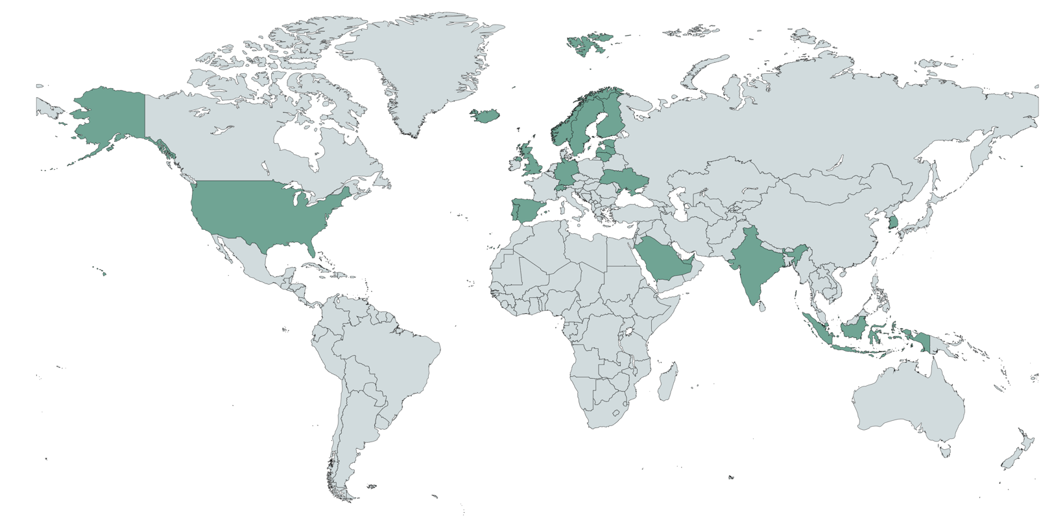
About us
Market demand
Solution & impact
Team and advisors
Contact us
Carbon Free Technologies (or “CFT) has developed patented solutions for creating recycled carbon neutral concrete utilising recycled construction demolition concrete waste mixed with fully bio-based application dependent additives (“RCA”). This solution is based on over 10 years of research and cooperation with universities, research institutes and other constituents. Producing the recycled concrete can be done both in concrete facilities and on-site.
CFT combines its innovations with its AI driven digital platform that allows us to manage the entire RCA value chain – all based on on-boarding of customer requirements and matching that with applicable RCA, as well as creates a marketplace for service providers in the value chain to become a part of the solution – all from one integrated ecosystem, one single dashboard.
Innovations: More than 10 years of R&D
Solution: Replace aggregates with RCA
combined with application-based additives and controlled value chain
Impact: Substantial reduction of waste, CO₂ and materially stronger concrete – significantly cheaper
Global: Fully modular and scalable with planned projects and pilots in several countries globally
Practical: Compatible with existing equipment – no new capex required
CFT innovations combined with an AI driven digital platform provide a fully scalable holistics approach to sustainable concrete production instead of trying to solve only one challenge in the value chain. In today’s environment providing such holistic circular economy solutions is the only option to solve the various financial and environmental challenges of producing concrete.
CFT was established by a team of sustainable business professionals with versatile backgrounds – from construction operations and other fields of business with unparallelled expertise.
Construction leadership
Concrete research
LEAN Management
Digital platform design
Structured finance
Global business management

Slide 4
About us
Market demand
Solution & impact
Team and advisors
Contact us
Demand for circular economy solutions in concrete production is rapidly increasing due to need to reduce dependence on virgin materials and waste, to reduce the CO2 footprint in construction, have reliable access to raw materials and to lower costs.
Current status is environmentally unbearable
Waste: Today concrete production accounts for 25-35% of all waste, depending on the country – CFT could fully utilize this waste
CO2: Concrete is one of largest sources of CO2 globally (largely due to cement production) – CFT could reduce the CO2 footprint
Biodiversity: Ability to replace sand and gravel in concrete would protects biodiversity – one of the corner stones in EU circular economy legislation
Other challenges: Numerous other environmental challenges can be mitigated, such as erosion, logistics, water pollution, etc.
Global challenges beyond ESG
Lack of access: Having access to suitable aggregates for concrete has become more challenging – creating conflicts even between nations
Aggregate imports: Aggregate imports are increasing creating challenges in logistics, scheduling, and costs – in addition to the environmental burden
Criminal behavior: Illegal sand mining is becoming one of largest organized criminal activities in various regions
Other challenges: Cost of logistics, increased lead times lack of efficiency and other project management concerns have become a major challenge
Financial opportunities relating to circular economy
USD +600bn industry: Continuously increasing demand for aggregates has created a USD +600 billion industry with demand for circular economy
Cheaper: Aggregate Replacing virgin aggregates with RCA Aggregates can offer a significantly cheaper alternative
Cost savings: Costs savings relating to aggregates, logistics, faster lead times, project management, on-site solutions significantly reduce project costs
CO2 reduction to profit: Being able to reduce CO2 by 0.1 tons per cubic meter of concrete can offer new avenues for additional profitability

Slide 5
About us
Market demand
Solution & impact
Team and advisors
Contact us
Demand for circular economy solutions in concrete production is rapidly increasing due to need to reduce dependence on virgin materials and waste, to reduce the CO2 footprint in construction, have reliable access to raw materials and to lower costs.
Current status is environmentally unbearable
Waste: Today concrete production accounts for 25-35% of all waste, depending on the country – CFT could fully utilize this waste
CO2: Concrete is one of largest sources of CO2 globally (largely due to cement production) – CFT could reduce the CO2 footprint
Biodiversity: Ability to replace sand and gravel in concrete would protects biodiversity – one of the corner stones in EU circular economy legislation
Other challenges: Numerous other environmental challenges can be mitigated, such as erosion, logistics, water pollution, etc.
Global challenges beyond ESG
Lack of access: Having access to suitable aggregates for concrete has become more challenging – creating conflicts even between nations
Aggregate imports: Aggregate imports are increasing creating challenges in logistics, scheduling, and costs – in addition to the environmental burden
Criminal behavior: Illegal sand mining is becoming one of largest organized criminal activities in various regions
Other challenges: Cost of logistics, increased lead times lack of efficiency and other project management concerns have become a major challenge
Financial opportunities relating to circular economy
USD +600bn industry: Continuously increasing demand for aggregates has created a USD +600 billion industry with demand for circular economy
Cheaper: Aggregate Replacing virgin aggregates with RCA Aggregates can offer a significantly cheaper alternative
Cost savings: Costs savings relating to aggregates, logistics, faster lead times, project management, on-site solutions significantly reduce project costs
CO2 reduction to profit: Being able to reduce CO2 by 0.1 tons per cubic meter of concrete can offer new avenues for additional profitability

Slide 6
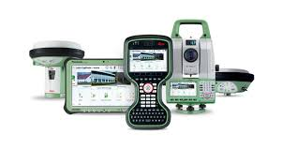

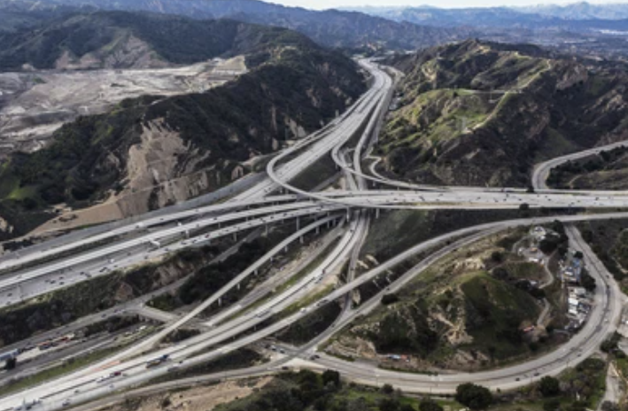
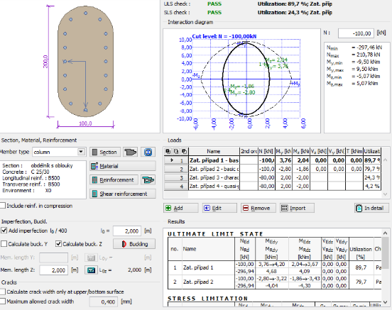
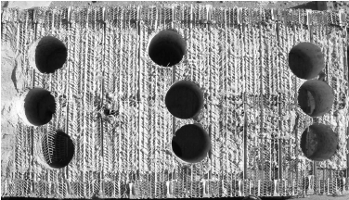
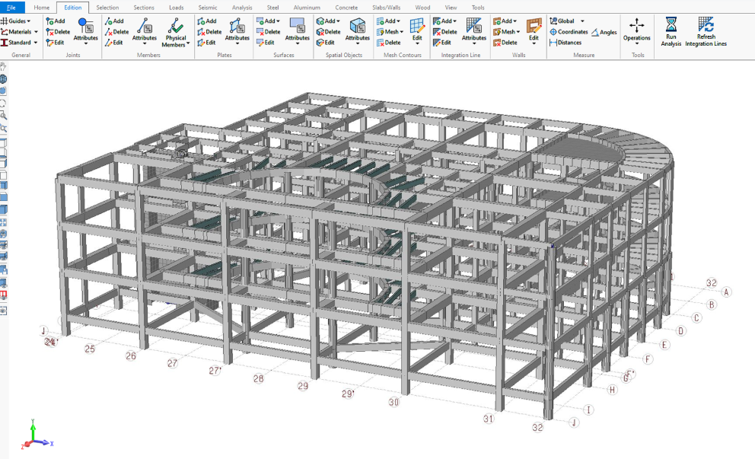
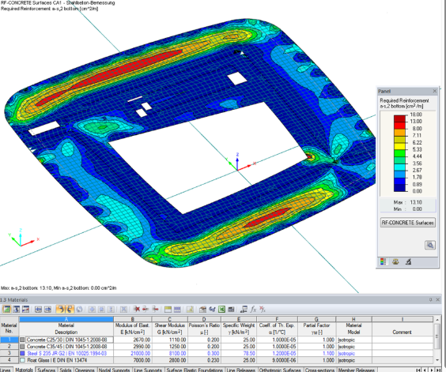
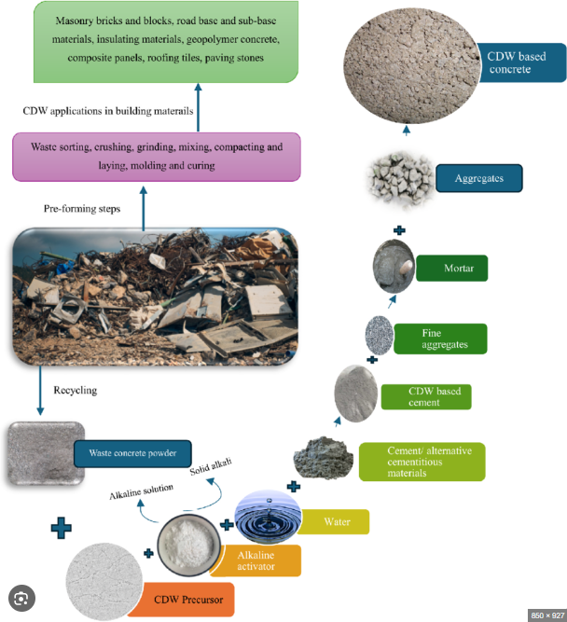
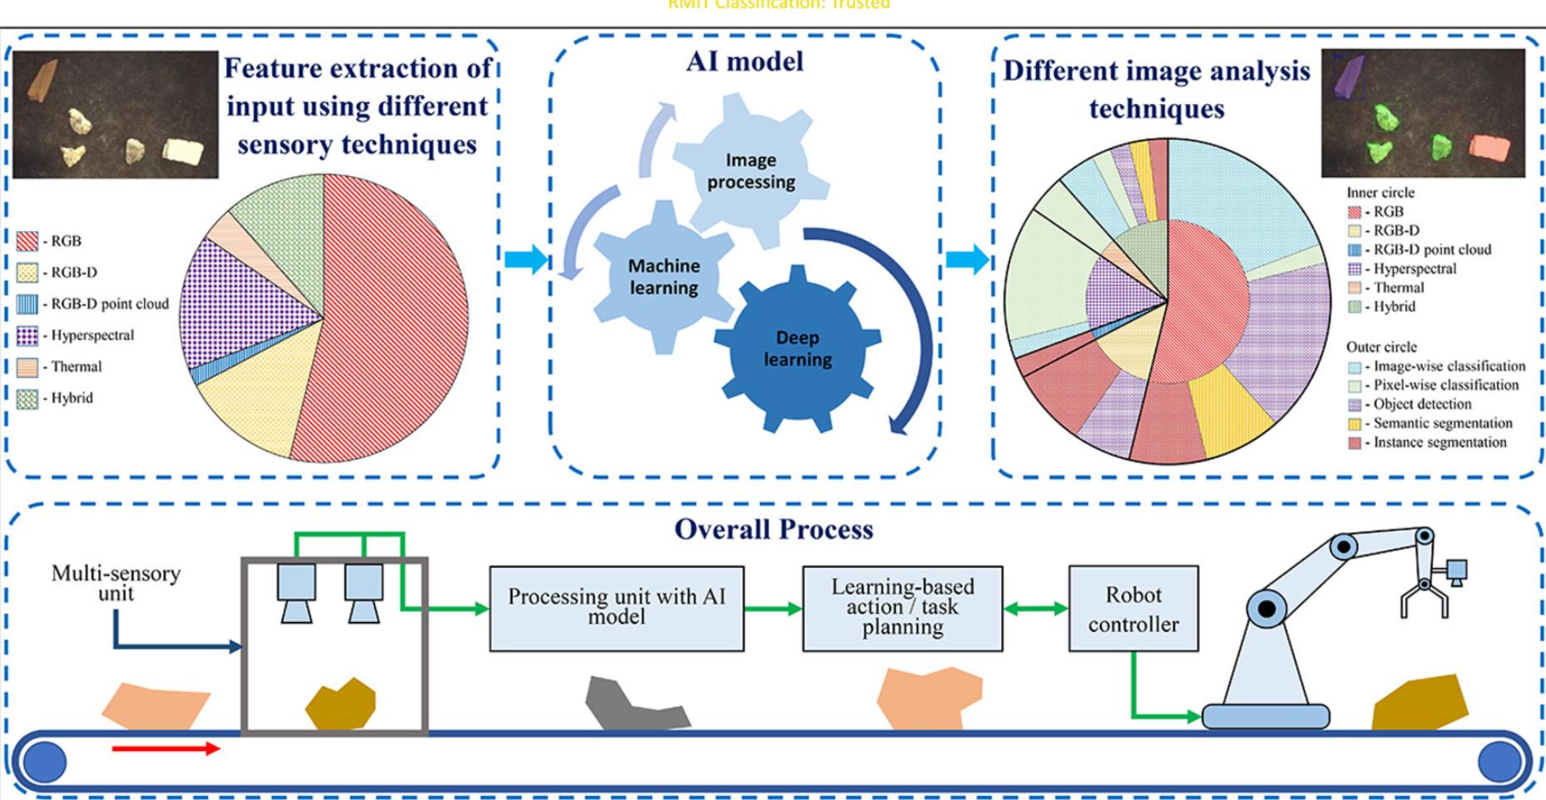


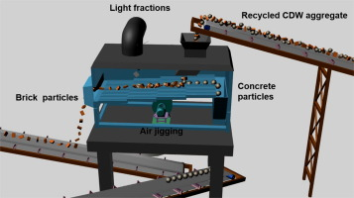
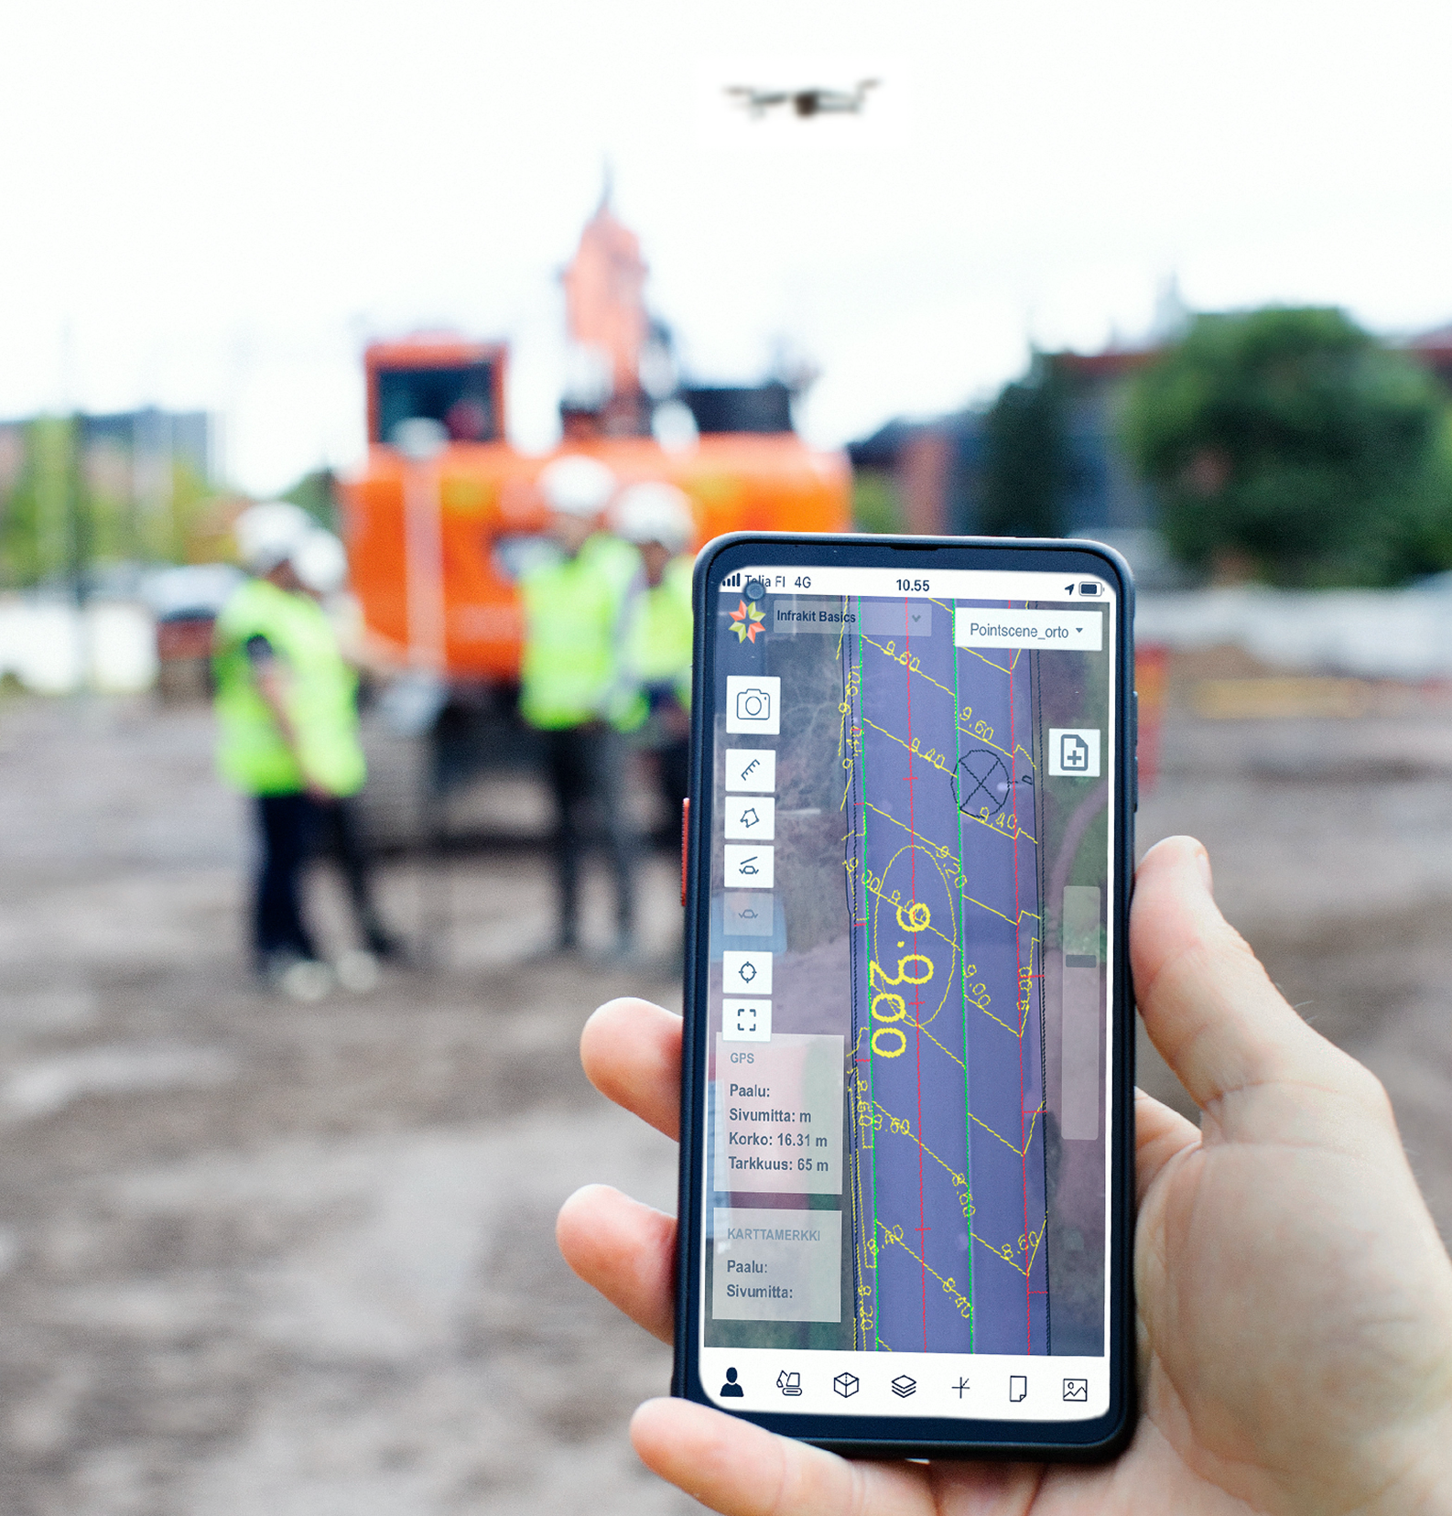
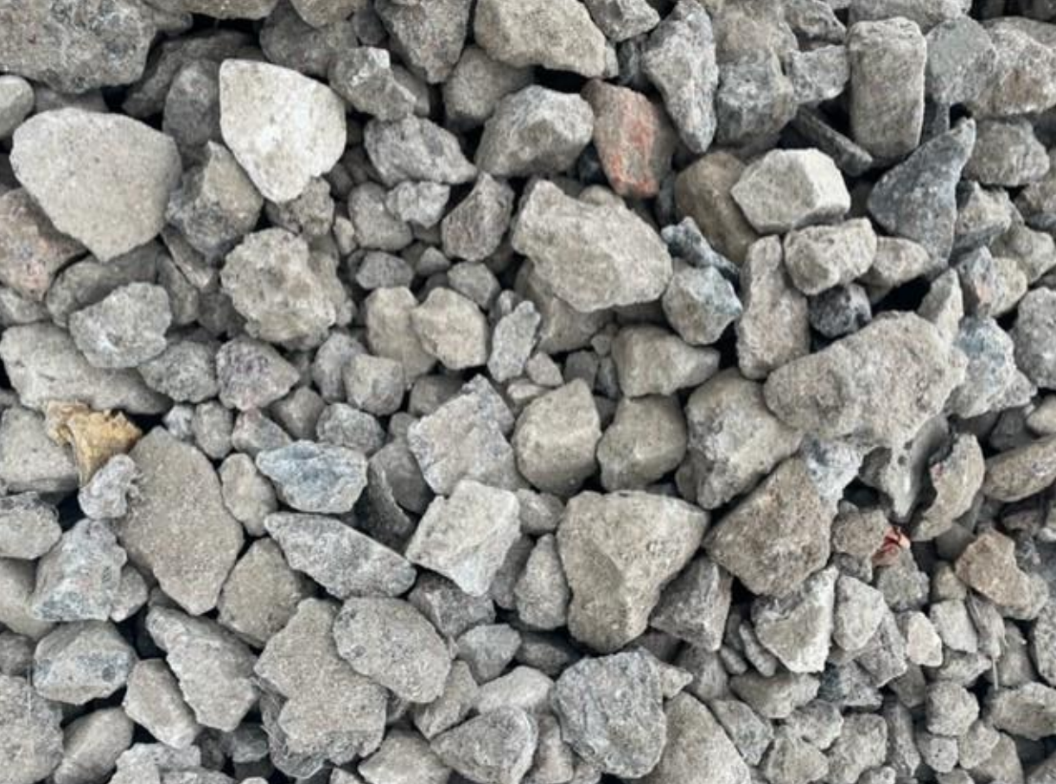
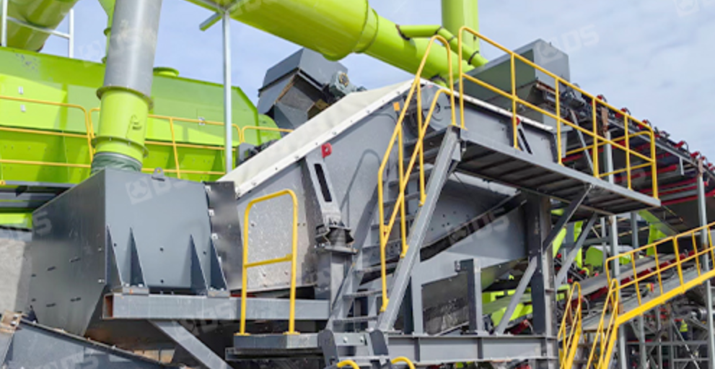
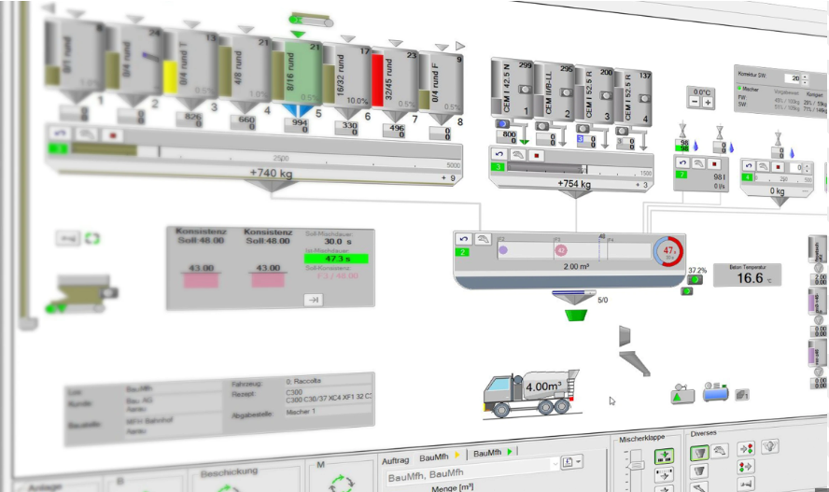
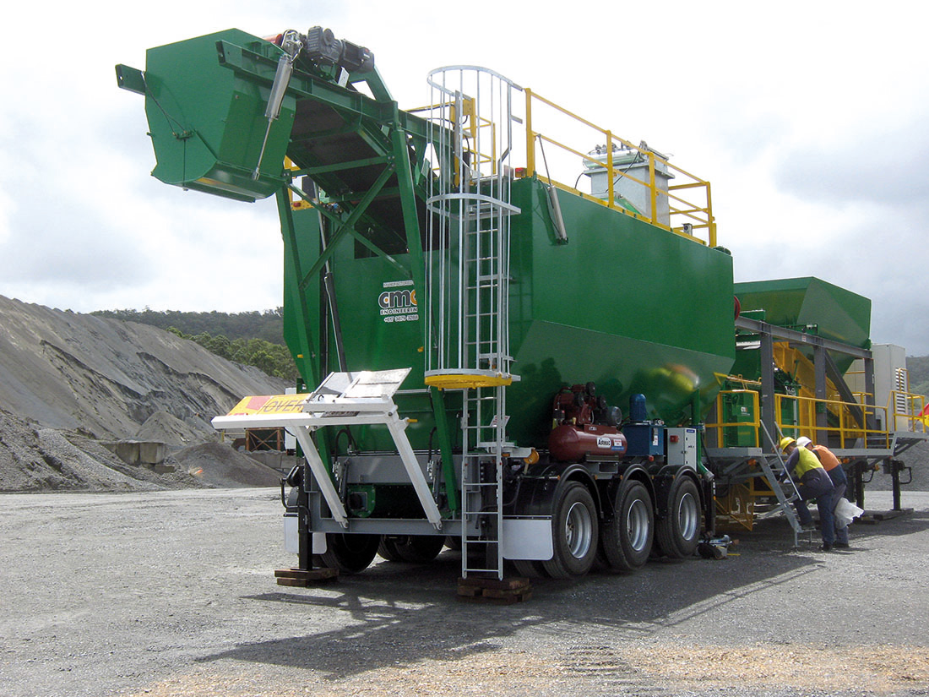
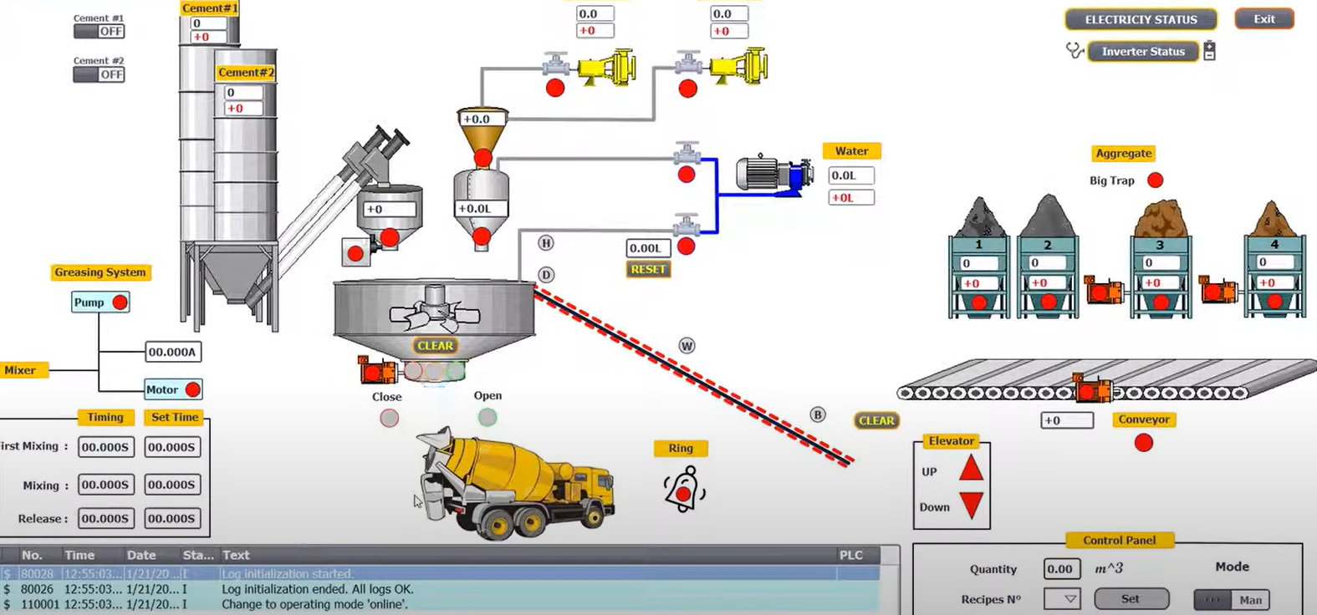
About us
Market demand
Solution & impact
Team and advisors
Contact us
Customer need drives generation of RCA (size and type of crushed concrete, type of additives, mixing plans, etc.).
On-boarding requirements and specifications from customers relating to the end-user applications are used to optimise the generation of RCA from CDW to replace aggregates when producing new concrete.
AI driven digital platform helps to manage the entire RCA value chain for access, costs and quality control.
Imaging and Certify (Data gathering)
Project owners and contractors
Classify and Process (AI Driven)
Applications & specifications
On-boarding
Crushing & Sieving (equipment today)
RCA Concrete – application-based mix & methodology
Mixing & Additives (global access)

Slide 7

About us
Market demand
Solution & impact
Team and advisors
Contact us
Time Savings and Lower Logistical Burden
CO2 savings to profit
Day-to-day Cost Reductions
On-site Circular Economy
Tangible CO₂ Reductions
Real-life on-site circular economy solution
Reduce up to 25-30% of all waste
Controlled RCA value chain
Controlled auditive base CDW concrete
Tangible savings from cost of raw materials, logistics costs and waste management expenses
CO2 reductions are substantial (ca. 40%)
Less cement needed
Additives tie in more CO2
CO2 required to provide traditional aggregates
Less logistics
Significant time savings from on-site concrete production and the logistical burden
Turning CO2 savings into profits (over 0.1 tonne carbon savings per 1m3 of concrete)

Slide 8
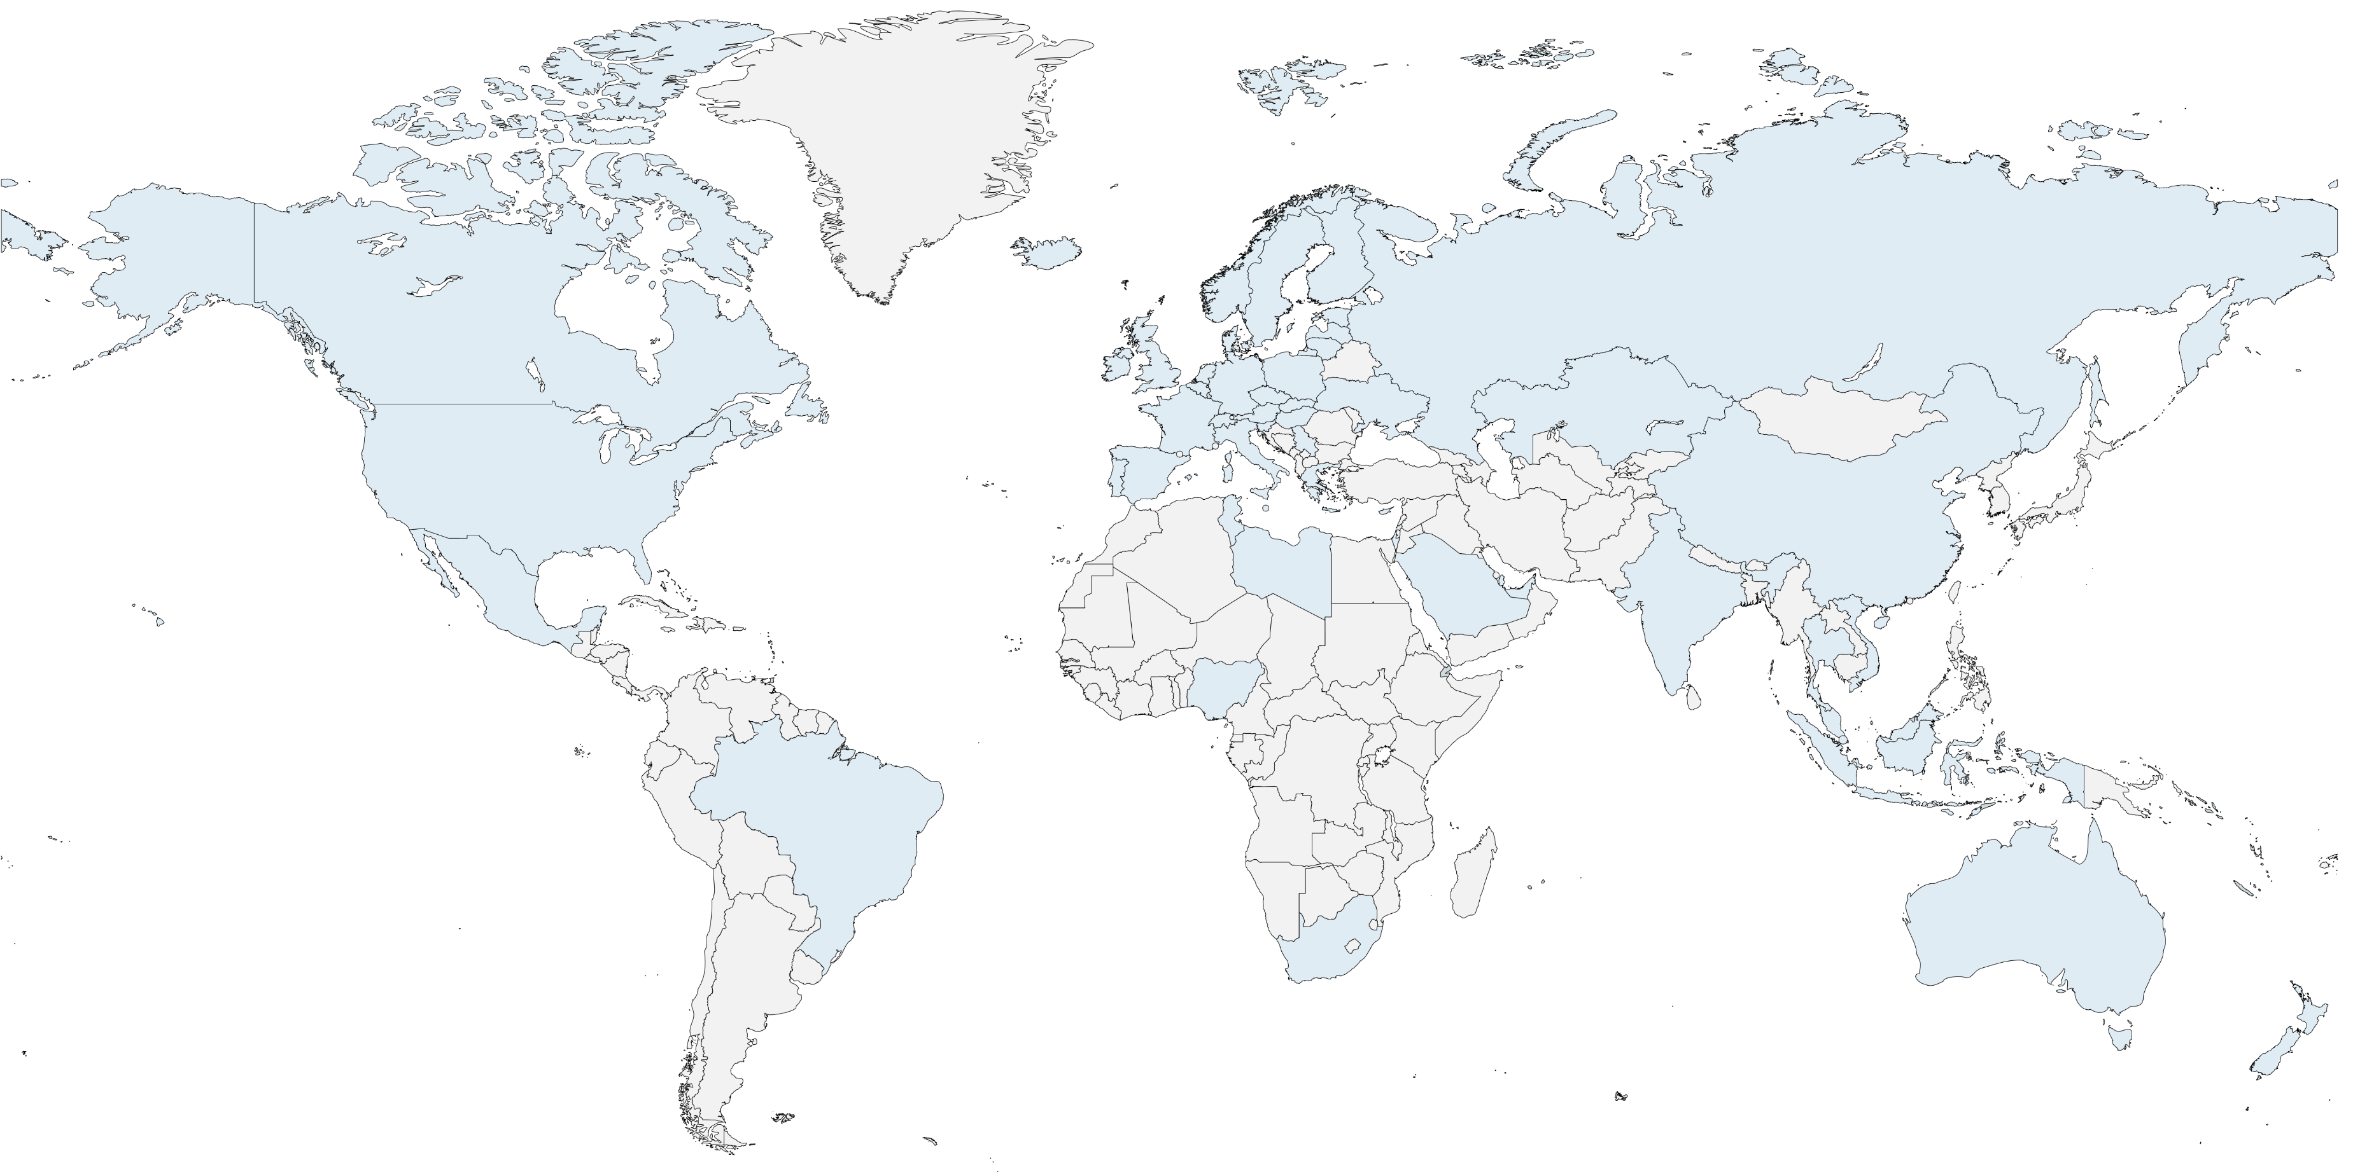













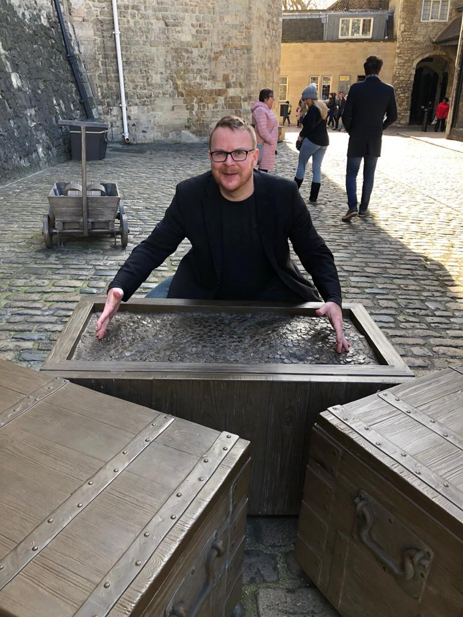
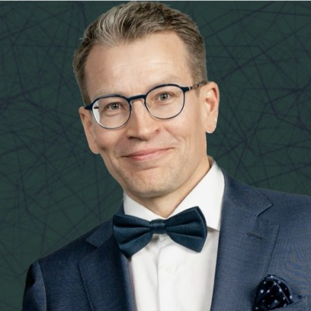
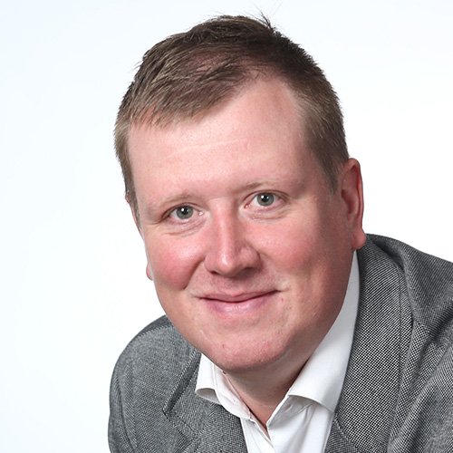
About us
Market demand
Solution & impact
Team and advisors
Contact us
CFT has an exceptional team consisting of sustainable business professionals with complementary capabilities – both among the core team members and the senior advisors. CFT markets access is built on relationships at selected markets, established support, operational partners, as well as financing and security. It is our approach to meet and speak with everyone - from janitors to officials.
100 Influencers
400 Consultants, bankers and other experts
500 Operational leaders and Board members
250 Senior advisors and local support
250 Industry elders and revered experts
300 Investors and insurance
200 Officials
Core team
Jukka Mäkelä
Jarkko Hämäläinen
Pekka Mairinoja
Sami Niku-Paavo
Teppo Rauhala
[ ]

Slide 9
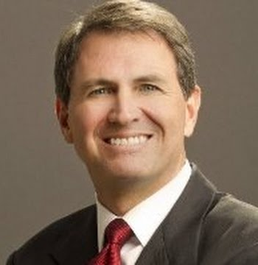
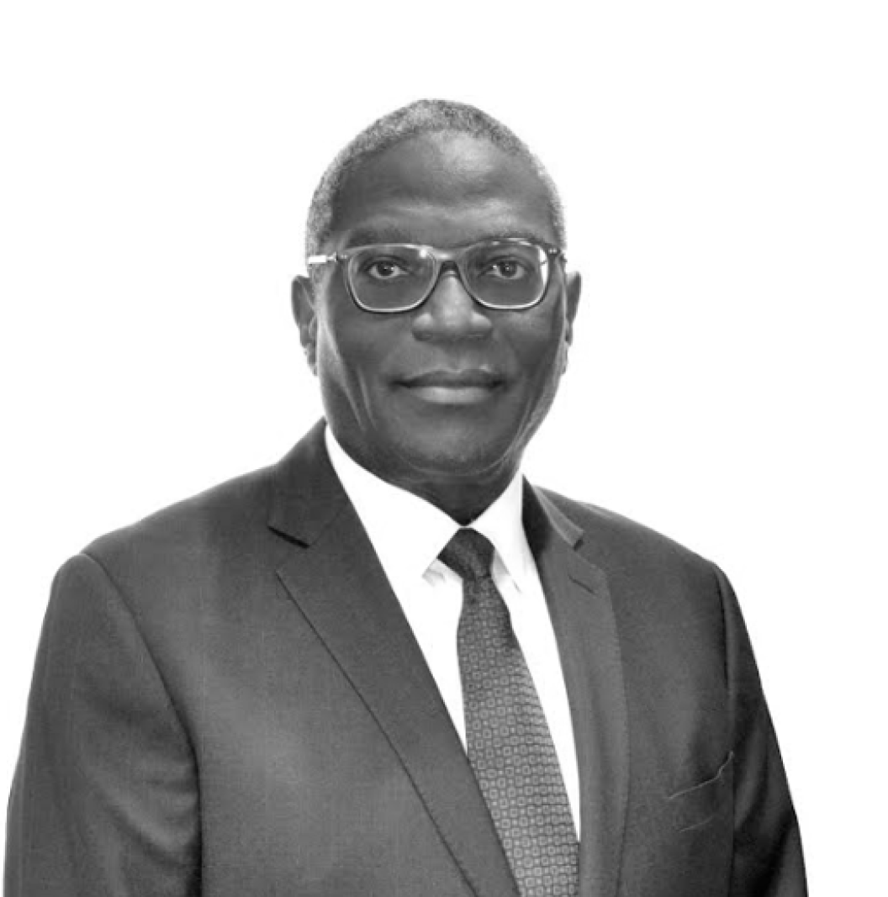
Senior advisors
Laird Cagan
Aitua Ekhaese
Anthony Rampensaud
Rauno Heikkilä
Kari-Pekka Laaksonen
Juuso Manninen
Kyle Douglas
David Gottfried

